Slide 1

HEALTHCARE INVESTMENT ANALYSIS
NorthBridge Health Investment Fund:
Which Hospital Deserves the Investment?
Greenfield General Hospital • Eastpoint Community Hospital • Riverside Medical Centre
Recommended:
Greenfield General Hospital
Clinically excellent, operationally disciplined, with a fixable financial gap and real room to scale.
Prepared by Stella Obase
Dataverse Africa | Healthcare Data Analyst Track, Cohort 4

Slide 2
PROJECT OVERVIEW
Three Hospitals have been shortlisted for a major capital investment by NorthBridge Health Investment Fund.
Only ONE will receive funding, This project analyzes the three Hospitals across different metrics and weights, then recommend the single strongest investment candidate supported directly by the data.
Greenfield General Hospital | Eastpoint Community Hospital | Riverside Medical Centre
3

Slide 3
The three Hospitals at a glance
KPI
GGH
ECH
RMC
Best
Total Encounters
3,600
3,500
3,800
RMC
Total Revenue
$2.32m
$4.07m
$6.63m
RMC
Collection Rate
29.1%
45.3%
56.9%
RMC
Denial Rate
50.6%
28.8%
14.6%
RMC
Mortality Rate
2.64%
4.37%
6.16%
GGH
HAI Rate
3.58%
4.29%
5.58%
GGH
Readmission Rate
9.39%
14.11%
19.66%
GGH
Complication Rate
10.89%
12.60%
17.82%
GGH
Patient Satisfaction
7.68
6.92
5.53
GGH
Avg LOS (days)
3.18
3.79
5.03
GGH
Avg ED Wait (min)
33.5
46.0
61.1
GGH
Encounters / Bed / Yr
6.43
9.21
3.96
ECH
Revenue YoY Growth
-18.5%
+5.7%
-0.2%
ECH
11

Slide 4
How was the analysis done?
Each hospital was evaluated across five metrics and scored 1-10 on 20 criteria across 5 weighted pillars.
Weighted Score = Weight x Raw Score; the sum of all 20 weighted scores is each hospital's Weighted Total Score out of 10.
Financial Performance - 22%
Revenue base, collection strength, billing-to-cash leakage
Clinical Quality - 30%
Mortality, infection, readmission, complication, recovery, satisfaction
Claims Efficiency - 18%
Denial rate, denied revenue at risk, claims processing speed
Operational Efficiency - 18%
ED wait time, encounters per bed/year, average length of stay
Growth & Scalability - 12%
YoY revenue/encounter growth plus Capacity Headroom
6

Slide 5
Greenfield General Hospital (GGH)
Clinically excellent and operationally disciplined, with a significant, but fixable revenue-cycle gap
3,600
$2.3M
29.1%
50.6%
7.68/10
Total Encounters
Revenue/Encounter
Collection Rate
Denial Rate
Avg Satisfaction
3.18
33.5
9.39%
10.89%
3.58%
Avg LOS (Days)
ED Wait (Min)
Readmission Rate
Complication Rate
HAI Rate
STRENGTHS
FIXABLE WEAKNESSES
Lowest mortality rate of the three hospitals (2.64%) and highest recovery rate (87.97%)
Best LOS (3.18 days) and fastest ED wait time (33.5 min) — most efficient throughput
Highest patient satisfaction (7.68/10) and lowest HAI (3.58%) and complication (10.89%) rates
Healthy capacity headroom (6.43 enc/bed/yr) — genuine room to scale once fixed
Collection rate just 29.1% ; fails to convert billed revenue into cash.
Denial rate 50.6% ; roughly half of all claims are denied.
Revenue/encounter $644; lowest of all three hospitals.
Revenue declined 18.5% YoY; the clearest signal of the revenue-cycle problem.
INVESTMENT PROFILE: CLINICALLY STRONG, FINANCIALLY REPAIRABLE
High reimbursement risk, but addressable through a targeted RCM engagement.
8

Slide 6
Eastpoint Community Hospital (ECH)
Steady, balanced operations with moderate returns — but capacity-constrained growth
3,500
$1163
45.3%
28.8%
6.92/10
Total Encounters
Revenue/Encounter
Collection Rate
Denial Rate
Avg Satisfaction
3.79
46.0
14.11%
12.60%
4.29%
Avg LOS (Days)
ED Wait (Min)
Readmission Rate
Complication Rate
HAI Rate
STRENGTHS
WEAKNESSES
Patient satisfaction mediocre at 6.92/10, below the 7.0 mark.
Running at 9.21 encounters/bed/year — near-max capacity, almost no headroom.
Encounter volume falling (-5.0% YoY) even as revenue rises.
No standout strength on any pillar — a balanced but undifferentiated profile
Good financial balance — $1,163 revenue/encounter and 45.3% collection rate.
Strongest headline revenue growth of the three hospitals (+5.7% YoY)
Moderate, acceptable quality profile — no single metric is alarming
Mid-pack operational efficiency, consistent performance across the board
INVESTMENT PROFILE: SAFE, STABLE, BUT CAPACITY-CAPPED
Moderate risk and moderate returns; its growth story is real but structurally limited by bed capacity
9

Slide 7
Riverside Medical Centre (RMC)
The strongest financial performer, but the weakest clinical-quality profile of the three
3,800
$1744
56.9%
14.6%
5.53/10
Total Encounters
Revenue/Encounter
Collection Rate
Denial Rate
Avg Satisfaction
5.03
61.1
19.66%
17.82%
5.58%
Avg LOS (Days)
ED Wait (Min)
Readmission Rate
Complication Rate
HAI Rate
STRENGTHS
CRITICAL WEAKNESSES
+
Revenue/encounter $1,744 — highest by far, and the strongest collection rate (56.9%)
−
Highest mortality (6.16%), complication (17.82%), and readmission (19.66%) rates of the three
+
Lowest denial rate (14.6%) — the most mature claims/revenue-cycle operation
−
Lowest patient satisfaction (5.53/10) — a reputational and retention risk
+
Highest patient volume (3,800) — strongest demonstrated market demand
−
Longest LOS (5.03 days) and ED wait (61 min) — clear throughput bottlenecks
+
Largest facility (480 beds) — greatest current scale
−
High capacity headroom (3.96 enc/bed/yr) reflects chronic underuse, not unmet demand
INVESTMENT PROFILE: FINANCIALLY DOMINANT, CLINICALLY WEAKEST
Strong balance sheet offset by materially weaker patient-safety outcomes — regulatory and reputational risk over a 5-year hold
10

Slide 8
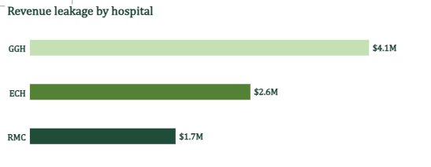
COMPARATIVE ANALYSIS
Financial Performance (22%)
RMC generates the strongest revenue base and collects the highest share of what it bills. GGH's revenue is smallest and its leakage
highest , but this traces to a claims-and-collections gap, not weak patient demand.
Scorecard Contribution
Criterion
GGH
ECH
RMC
Total Revenue 3 5 8
Collection Rate
4
6
8
Revenue Leakage
4
6
6
NorthBridge Health Investment Fund | Hospital Investment Case | Confidential
12

Slide 9
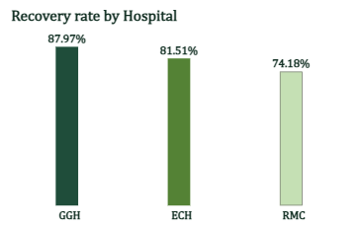
Clinical Quality (30%) — largest weight
GGH leads on every clinical-quality metric measured. RMC, despite its financial strength, posts the weakest results across this entire
pillar. This is the single most heavily weighted pillar in the framework.
Scorecard Contribution
Criterion
GGH
ECH
RMC
Mortality Rate
9
7
4
HAI Rate
9
7
5
Readmission Rate
9
6
3
Complication Rate
8
7
4
Recovery Rate
9
8
6
Patient Satisfaction
7
7
5
13

Slide 10
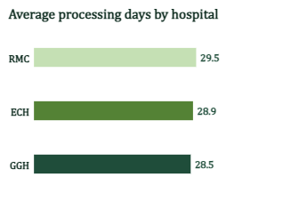
Claims Efficiency (18%)
RMC's revenue-cycle operation is the most mature, with the lowest denial rate and least revenue at risk. GGH's high denial rate is the
single largest identifiable, fixable lever for improving its financial position.
Scorecard Contribution
Criterion
GGH
ECH
RMC
Denial Rate
3
6
9
Denied Revenue at Risk
3
5
8
Avg Processing Days
8
7
6
14

Slide 11
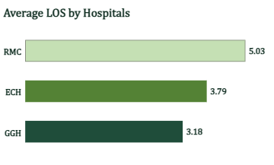
Operational Efficiency (18%)
GGH has the shortest ED wait time and shortest average length of stay. ECH posts the highest raw encounters/bed/year — but as the
next slide shows, that signals near-max capacity, not superior efficiency.
Scorecard Contribution
Criterion
GGH
ECH
RMC
Avg ED Wait Time
8
6
4
Encounters per Bed/Yr
6
9
4
Avg LOS
8
6
5
15

Slide 12
Growth & Scalability (12%)
ECH's revenue grew fastest (+5.7%), but it runs at 9.21 encounters/bed/year, near-max capacity, with little room to scale. GGH’s
revenue declined (-18.5%) but it has healthy headroom (6.43 enc/bed/yr) once its RCM gap is fixed.
Scorecard Contribution
Criterion
GGH
ECH
RMC
Revenue YoY Growth
6
6
4
Encounter Volume YoY Growth
6
2
7
Capacity Headroom
9
1
10
16

Slide 13
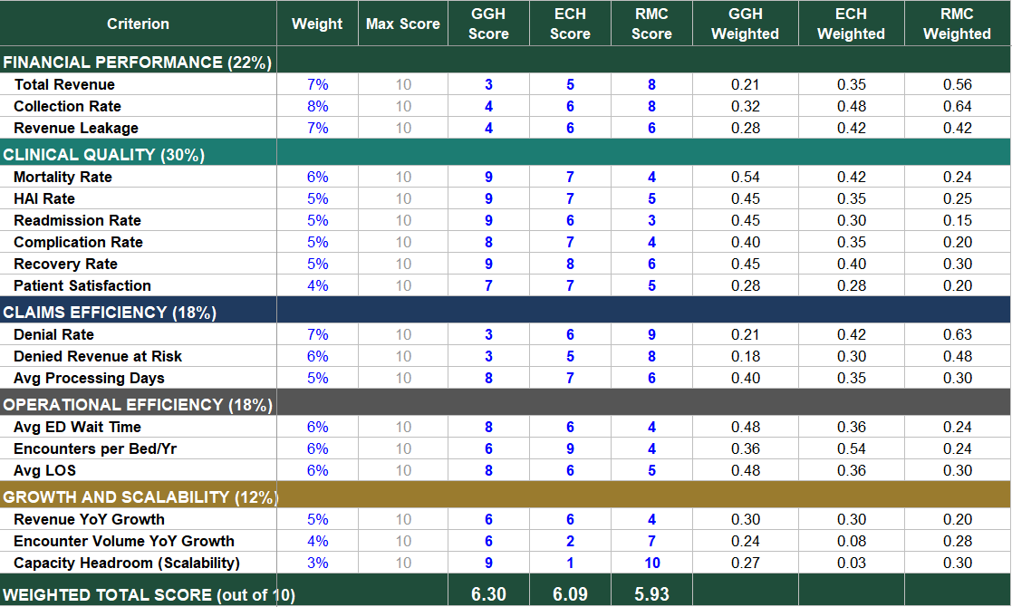
Weighted Total Scorecard
Across all 5 pillars and 20 criteria, Greenfield General Hospital finishes first on weighted composite score, driven by clinical-quality
leadership and genuine, capacity-backed room to scale.
17

Slide 14
Summary of Findings
GGH leads on clinical quality and operational discipline: Lowest mortality, HAI, readmission, and complication rates; highest recovery rate; shortest ED wait and LOS.
GGH's financial weakness is a fixable revenue-cycle problem: A 50.6% denial rate and 29.1% collection rate — not a demand or quality problem — explain its low revenue score.
RMC is financially dominant but clinically the weakest: Highest revenue/encounter and best collections, offset by the highest mortality, complication, and readmission rates.
ECH's growth is real but structurally capped: Fastest revenue growth (+5.7%) is offset by near-max bed utilization (9.21 enc/bed/yr) — little room left to scale.
GGH wins on weighted composite score: 6.30 / 10 vs. 6.09 (ECH) and 5.93 (RMC); a narrow but consistent lead across the 20-criteria framework.
18

Slide 15
Investment Recommendation
RECOMMENDED: Greenfield General Hospital (GGH)
6.30 / 10
Weighted score: 6.30 / 10 ; the highest of the three candidates
Why GGH?
Why not ECH?
Why not RMC?
Highest clinical-quality scores across all six metrics.
Denial rate and revenue are fixable via RCM engagement, not demand or care issues.
Healthy capacity headroom (6.43 enc/bed/yr) to convert reform into real growth
Balanced but average; no standout performance on any pillar.
Growth is capped by near-max bed utilization (9.21 enc/bed/yr).
Mid-pack clinical quality limits long-run upside versus GGH
Highest mortality, complication, and readmission rates of the three.
Lowest patient satisfaction (5.53/10) — reputational and retention risk.
Financial strength offset by regulatory/quality risk over a 5-year hold
19

Slide 16
Risks, the 90-Day Roadmap and growth opportunities for GGH
KEY RISKS TO MONITOR
Smallest current revenue base means a slower absolute payback even after collections improve.
RCM turnaround execution risk; improvement depends on successfully hiring/engaging a revenue-cycle partner.
ECH and RMC remain credible alternatives if GGH's denial-rate fix stalls.
90-DAY PATH TO CLOSE:
Weeks 1-4: Confirmatory due diligence on GGH's revenue-cycle operations and top denial-reason categories.
Weeks 5-8: Engage a revenue-cycle-management partner to design the denial-reduction and collections work plan.
Weeks 9-12: Finalize investment terms, capacity-expansion scope, and a 12-month performance covenant tied to collection rate and denial rate.
GROWTH OPPORTUNITIES ONCE THE RCM GAP IS CLOSED
Recover denied revenue: $4.06M in denied claims at risk; even a partial recovery materially changes GGH's cash position.
Reinvest in capacity: 6.43 enc/bed/yr headroom supports real volume growth once cash flow stabilizes.
Protect the quality shield: Best-in-class clinical outcomes are the hardest thing for a competitor to replicate. Protect them through the transition
.
20

Slide 17
CONCLUSION
The Investment Case for NorthBridge Health Investment Fund
RECOMMENDED
2nd Choice
3rd Choice
Greenfield General (GGH)
Eastpoint Community (ECH)
Riverside Medical (RMC)
6.30/10
6.09/10
5.93/10
Weighted Score
Weighted Score
Weighted Score / 10
Clinically excellent, operationally disciplined, with a fixable financial gap and real room to scale.
Safe and stable with moderate returns, but growth is structurally capped by bed capacity.
Financially strongest, but the weakest clinical-quality and satisfaction profile of the three.
Thank you.

